Slide 1
Predicting emergent linguistic compositions through time: Syntactic frame extension via multimodal chaining
Author: Lei Yu, Yang Xu
Presenter: Mingyi Li
Oct 31, 2022

Slide 2
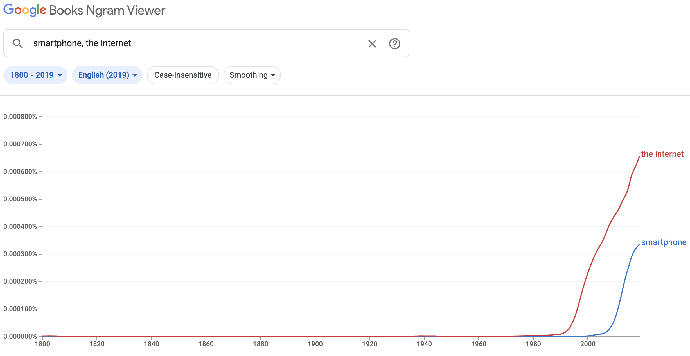
Motivation

Slide 3
Motivation
I _____ my iPhone to _____ the internet.
make
swipe
hit
walk
surf
touch

Slide 4

Motivation
express
Dilemma: bounded/finite lexicon unbounded emerging ideas
What are some of the newly emerged ideas that are difficult to express with existing vocabulary? How may we bridge this gap of communicative needs?
Can you think of an example where a new composition was built
combining an existing linguistic unit and an emerging term?
(Hint: millennials should be able to recollect many novel things
or actions that were not coined by a purely new expression)
https://www.asianage.com/technology/in-other-news/111216/soon-charge-your-smartphone-with-a-finger-swipe.html
Notes:
Address的目标研究问题，发散，小组提问

Slide 5
Some Examples
Ship a relationship
Snap a picture/photo/shot
Catch a bus
Drive a car
Ride a bike
Pilot an aircraft
Fly a kite

Slide 6
Syntactic Frame
What are the constituents of a syntactic frame?
1. A predicate verb
2. A syntactic relation (direct object)
3. A set of argument nouns
A syntactic frame is not static over time:
“Smartphone” is a new direct object in the 2000s
“Kill” is a new predicate of computing process in the 1970s
Notes:
Explain constituents with concrete example: “swipe your smartphone”
A predicate is the part of a sentence, or a clause, that tells what the subject is doing or what the subject is. Let's take the same sentence from before: “The cat is sleeping in the sun.” The clause sleeping in the sun is the predicate; it's dictating what the cat is doing.
A syntactic relation is a relation holding between a constituent and the clause that it forms part of. The most important syntactic relations are: subject. object (direct and indirect) adverbial.

Slide 7
Research Problem
Novel compositions are common but hard to predict
New words appear
Existing words develop new meanings
How can we utilize computational methods along with linguistics theories to tackle this challenge?
Notes:
常见新组词：新动词or旧动词新意义metaphor/metonymy + 旧名词；反过来
Domain +
GPU power + big data(CV&NLP)

Slide 8
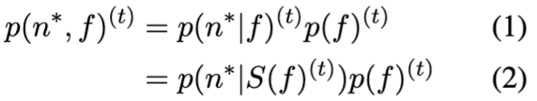
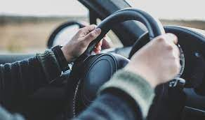
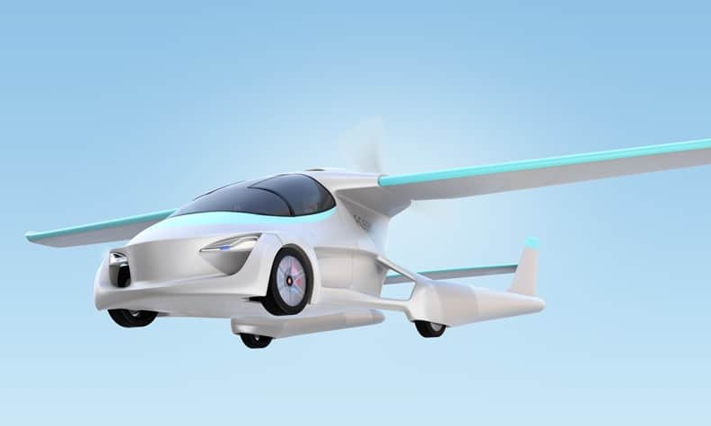
Contribution
Compositionality -> linguistic creation
Temporally formed verb-argument compositions: unattested
Systematic compositionality: in which SOTA neural networks lack
Principles in the formation of new verb-nouns: no attempt yet
Syntactic Frame Extension: an inferential process
Syntactic Frame: a joint distribution over a verb predicate, its noun arguments and their syntactic relations
Focus on 2 predictive problems:
noun -> “emerging” verbs & syntactic relations
verb & syntactic relation -> ”emerging” nouns
Can you think of a potential result for each problem?
https://www.travelers.com/resources/auto/
https://unitingaviation.com/news/safety/is-there-an-autonomous-flying-car-in-your-future/
Notes:
现存模型/研究未解决的问题
Joint dist: formula on page ?
Systematic compositionality?
Predicate: the part of a sentence or clause containing a verb and stating something about the subject (e.g., went home in John went home ).
Syntactic relation = syntax frame
Syntactical relation: is the mutual connection of elements in syntactical units, A syntactic relation is a relation holding between a constituent(part) and the clause that it forms part of.
The most important syntactic relations are:
subject
object (direct and indirect)
adverbial
Detection -> Discovery

Slide 9
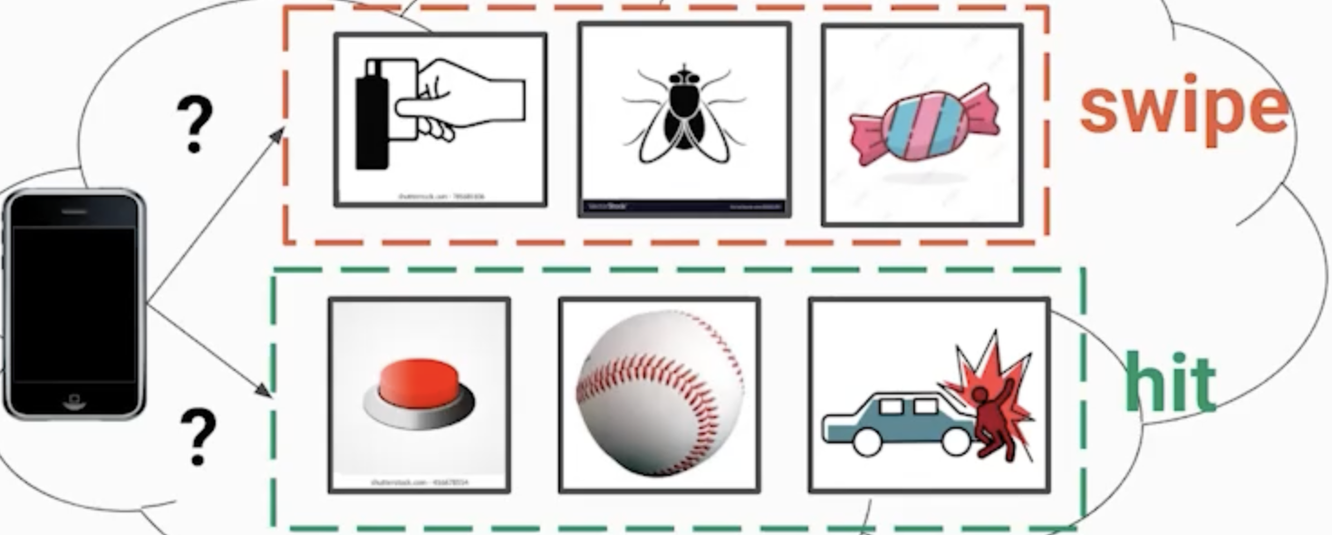
Syntactic Frame Extension as Categorization
https://aclanthology.org/2021.emnlp-main.71.mp4
Notes:
Computational representation of multimodal semantics

Slide 10
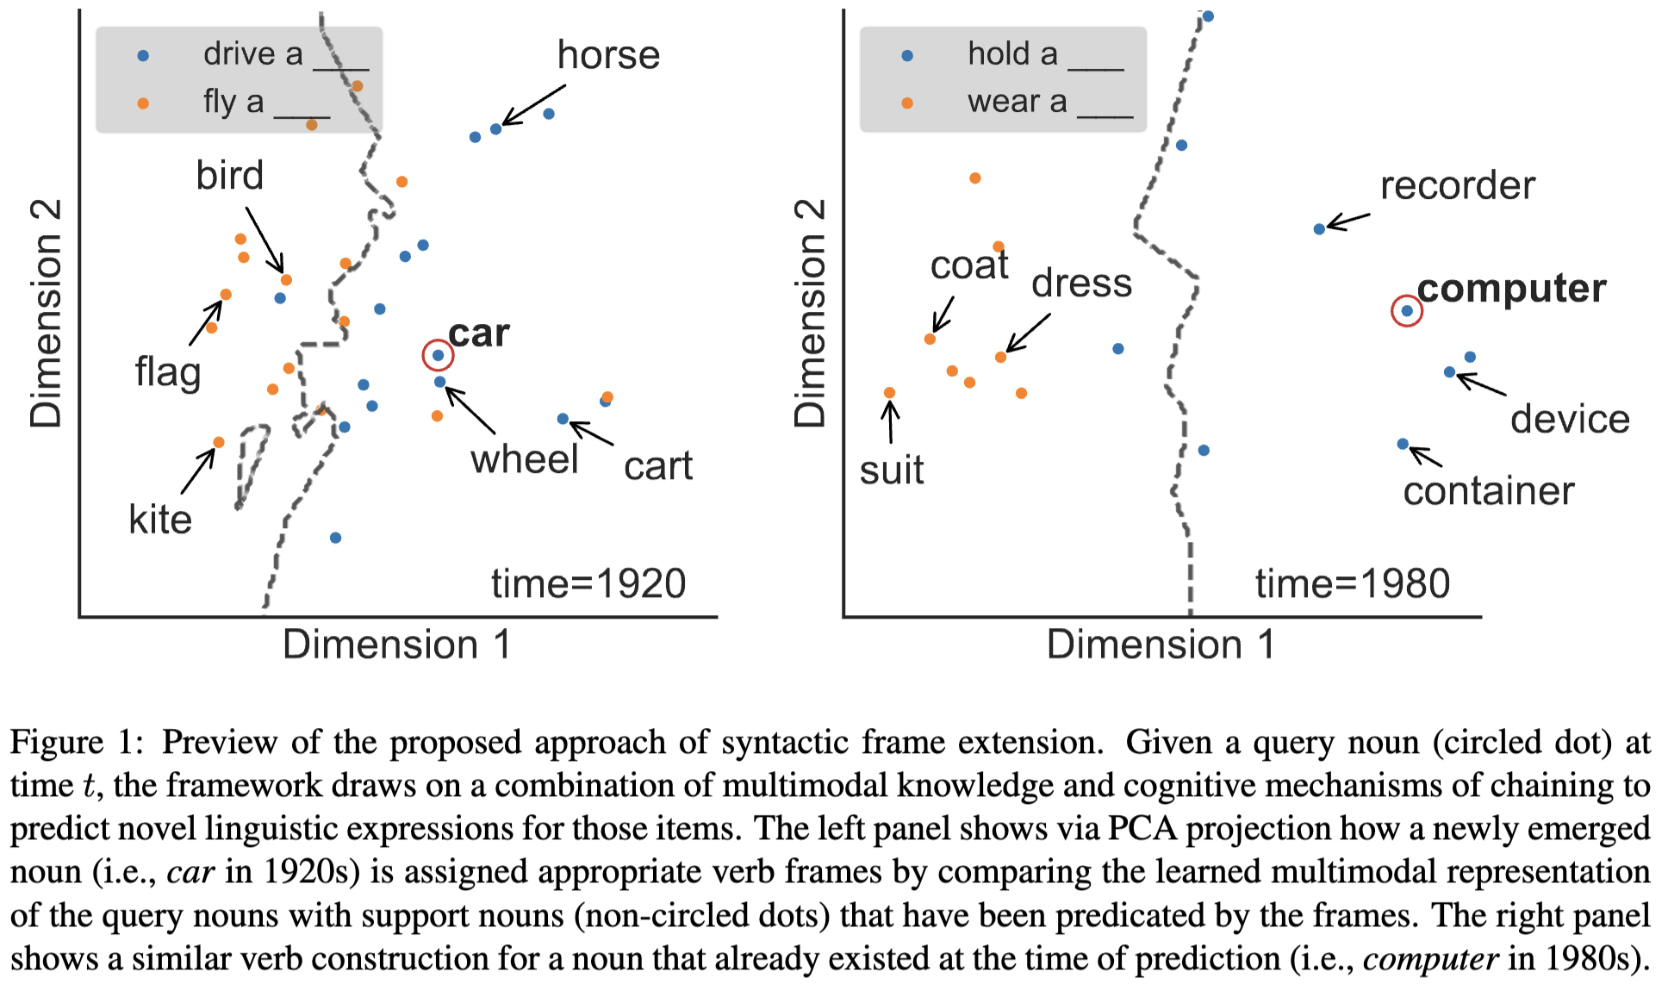
Preview of Framework
Notes:
INTERPRET!!!!!
The model is incorporated with perceptual and conceptual knowledge
Visualized via PCA the process of assigning novel verb frames to describe 2 query nouns over time:
left: successfully predicts [drive] > [fly] as a verb predicate for noun [car] when [car] just emerged in 1920s -> emergent verb composition with a <novel> noun concept
right: successfully predicts [hold] > [wear] for noun [computer] already existed in 1980s -> emergent verb composition with an <existing> noun concept

Slide 11

Related Work
Cognitive mechanisms of chaining
Why: frame extension is not arbitrary
How: link the novel to the existing on semantic proximity
Missed perceptual & relational info (Metaphor & Metonymy)
Multimodal meaning representation
https://www.google.com/url?sa=i&url=https%3A%2F%2Fdevpost.com%2Fsoftware%2Fword-chain-ve4ugq&psig=AOvVaw2NLCpDEvGQ6TYy4xVe5yZ9&ust=1666303029190000&source=images&cd=vfe&ved=2ahUKEwiM_7TSpO36AhVAn3IEHVD6Ae8Qr4kDegUIARDtAQ
Notes:
快 带过
However, no formalized or evaluated theory in predicting verb frame extensions through time

Slide 12
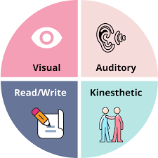
Related Work
Cognitive mechanisms of chaining
Multimodal meaning representation
“Richer” representation than unimodal
Image-text embedding disambiguates verb meanings
https://www.academyofmine.com/what-is-multimodal-learning-why-you-should-use-it-in-elearning/
Notes:
However, multimodal semantic representations have neither been examined in the diachronics of compositionality nor in light of the cognitive theories of chaining

Slide 13
From Related Work
Cognitive mechanisms of chaining
Multimodal meaning representation
This paper connects cognitive linguistic chaining theories & computational multimodal semantics: a unified framework
[perceptual] + [conceptual] + [linguistic]
What kind of inputs can represent these knowledge?
Any famous datasets ring in your mind?
Notes:
Image + knowledge graph + linguistic knowledge

Slide 14
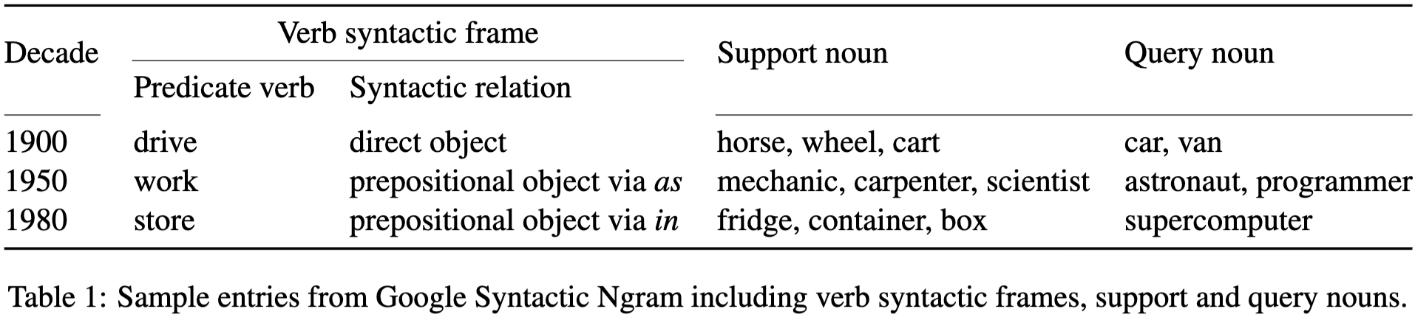
Data
Google Syntactic N-grams (GSN)
Raw syntactic N-grams data
All frame usages are extracted from the 99 files under the "Verbargs" subcategory
ConceptNet
ConceptNet assertion data
Train ConceptNet embeddings with "anachronistic" concepts pruned out in historical decades
ImageNet
the ImageNet dataset
Pre-processed visual representations produced

Slide 15
Computational Approach
Step 1: Specify the joint distribution
Step 2: Infer from multimodal knowledge over time
Notes:
aforementioned joint probabilistic dist p(f,n), recall the formulas

Slide 16
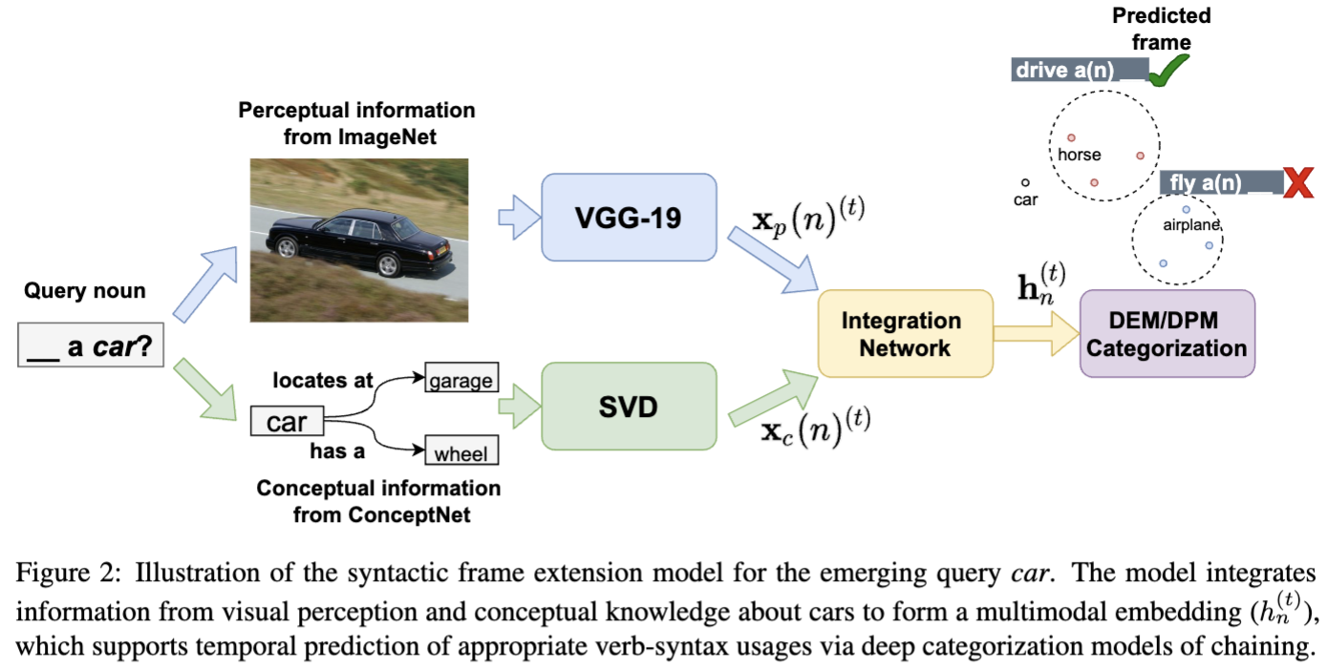
Computational Approach

Slide 17
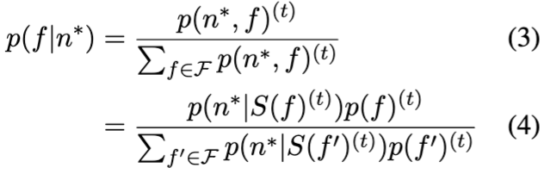
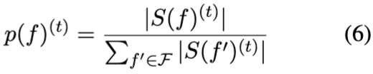
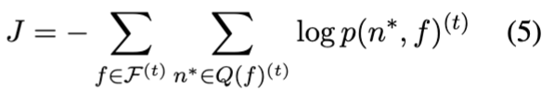
Computational Approach Chaining as probabilistic categorization
Syntactic Frame Extension Model (SFEM)
Given a query noun n*
Frequency-based prior for frames:
Objective function to minimize:
Notes:
A lexical chain is a sequence of related words
Rome → capital → city → inhabitant
Wikipedia → resource → web
A chain is independent of the grammatical structure of the text and in effect it is a list of words that captures a portion of the cohesive structure of the text.
A lexical chain can provide a context for the resolution of an ambiguous term and enable identification of the concept that the term represents
ANNOTATE WHAT SYMBOLS ARE!!!!
Define n* the emerging query noun for a given frame f: if (n*,f) co-occurrence counts at t fall below preset theta_q (binned by decade) while at t+decade > theta_q
theta_q = 10
Define support nouns S(f) as: co-occurred with the given f > theta_s at t
theta_s = 100
(1)
Why p(n*|f)*p(f) not p (f|n*)p(n*)
(2)
f -> S(f)

Slide 18
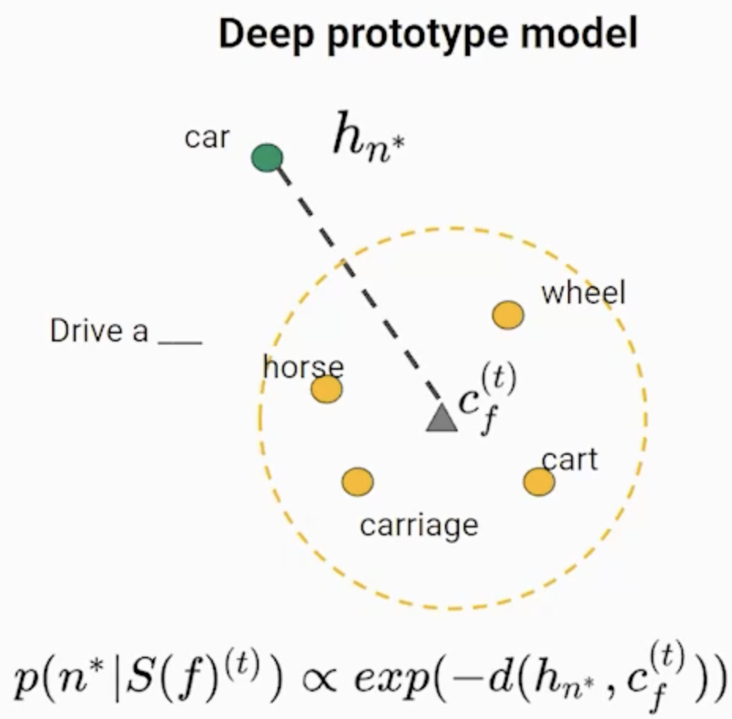
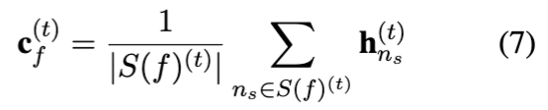
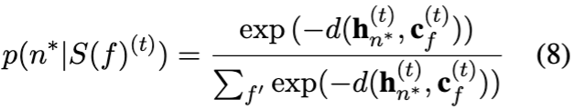
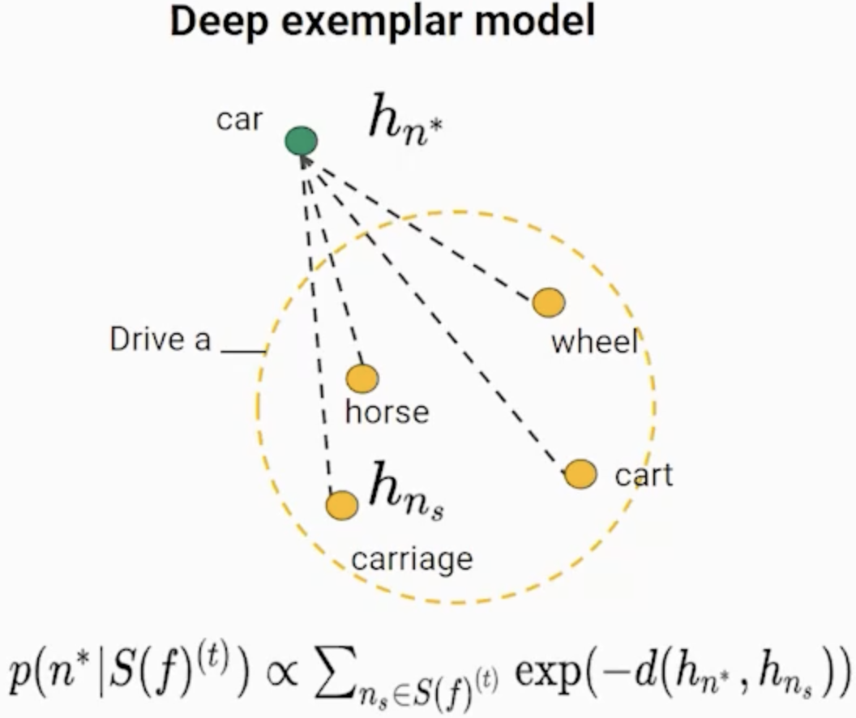
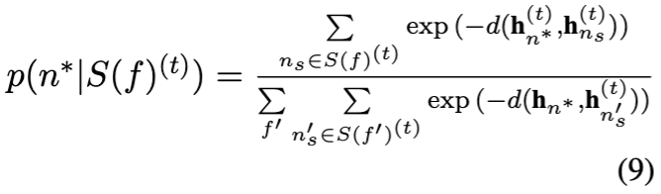
Computational Approach Chaining as probabilistic categorization
Deep prototype model (SFEM-DPM)
Deep exemplar model (SFEM-DEM)
Notes:
first show the figures only (get the intuition across),
and then stagger in the equations afterwards (formalism second, after the intuition is explained first).
对于似然函数，用深度categorization models
DPM：基于prototype theory of chaining & prototypical networks
DEM：基于exemplar theory of chaining & matching networks

Slide 19
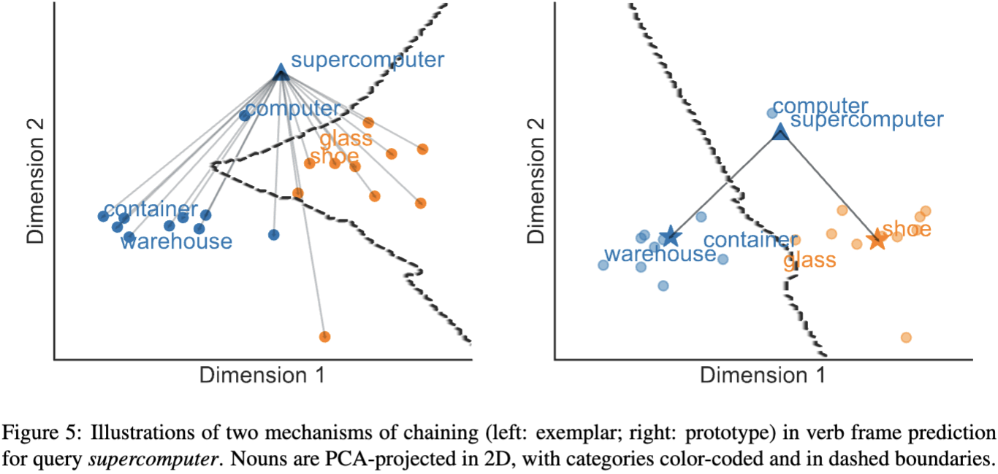
Computational Approach DPM 🆚 DEM (cont’d)

Slide 20
Computational Approach Multimodal knowledge integration
Perceptual knowledge
For each noun n,
Randomly sample 64 images from synsets containing n
Encode through VGG-19 by taking the output vector
from the last fully connected layer
Average the vectors to a mean vector
as the perceptual representation of n
Conceptual knowledge
Linguistic knowledge
Knowledge integration
Notes:
VGG-19: a CNN

Slide 21
Computational Approach Multimodal knowledge integration
Perceptual knowledge
Conceptual knowledge
For each time t
Remove words under preset thresholds -> ConceptNet graph
Perform SVD on the PPMI matrix of the graph
Combine the top 300 dimensions & context matrix -> Concept embedding
Linguistic knowledge
Knowledge integration
Notes:
Knowledge graph: relations as edges, reflect commonsense knowledge of a noun including 1. functional role 2. taxonomic information 3. attributes
( a car 1. is_used_for transportation 2. is_a vehicle 3. has_a wheel)
such relations(edges) can change over time
THRESHOLD: 读paper！

Slide 22
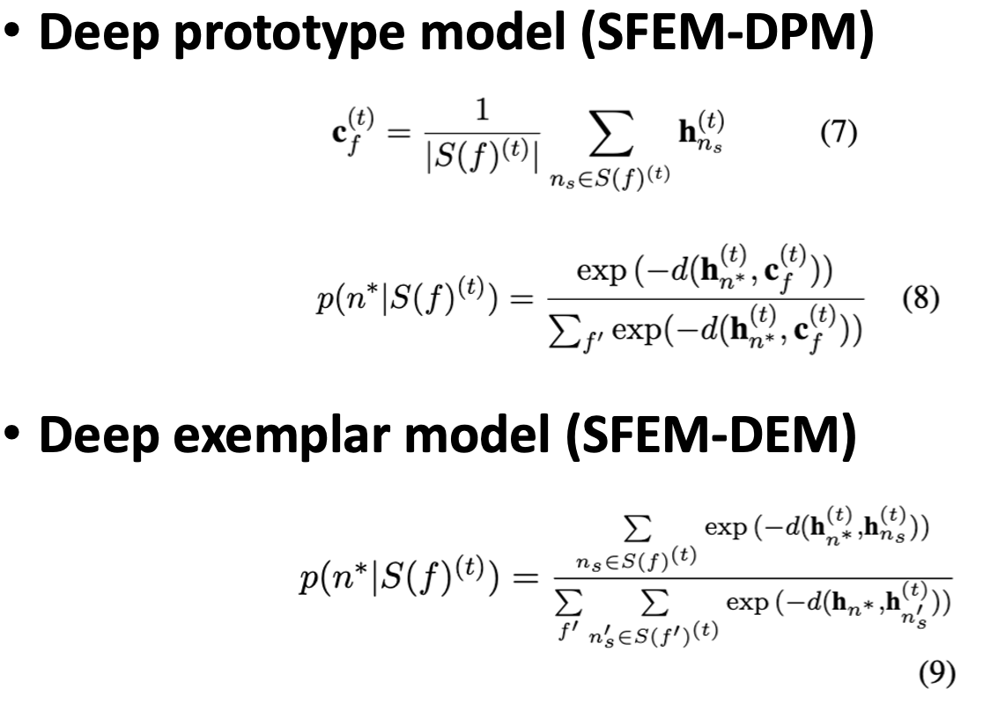
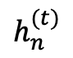
Computational Approach Multimodal knowledge integration
Perceptual knowledge
Conceptual knowledge
Linguistic knowledge
For each noun n at time t
use pretrained HistWords diachronic embeddings
Knowledge integration
For each noun n at time t
Take the mean of the unimodal representations –> joint vector
Apply an integration function, a 3-layer feedforward network ->
$$h_{n}^{(t)}$$
Notes:
HistWords vectors & the “joint” vectors: 300 dimensions
FFNN output dimension: 100
Each decade, randomly sample 70% to train & 30% non-overlapping to test
RESULTS FROM PREPROCESS: 10,349 verb-syntactic frames over 15 decades, each frame has >=1 n* & >= 4 S(f)

Slide 23
Evaluation
On the contributions of knowledge from 3 modalities versus
percept + concept
concept + linguistic
only percept
only concept
only linguistic
frequency
On the categorization models of chaining

Slide 24
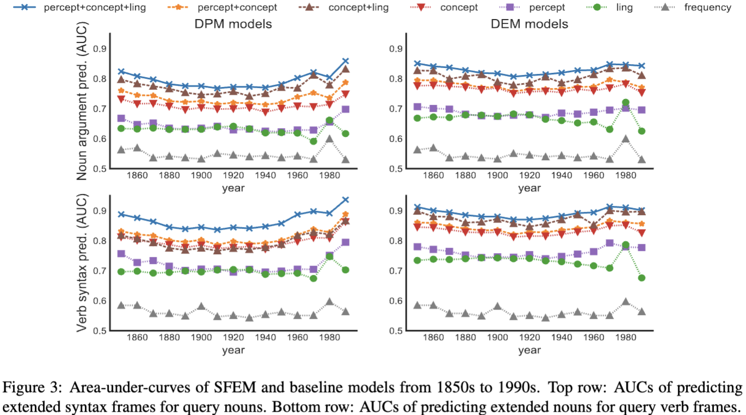
Evaluation
baseline
Notes:
AUC: receiver operating characteristic (ROC) curve, a plot of test sensitivity as the y coordinate versus its 1-specificity or false positive rate (FPR) as the x coordinate, is an effective method of evaluating the performance of diagnostic tests.
What can you summarize from this graph?

Slide 25
Evaluation
To further assess how these models perform in predicting emerging verb extension toward both novel & existing nouns
Report separate mean AUC scores for 2 predictive cases:
0 token frequencies == n completely novel
Above 0 token frequencies == established n

Slide 26
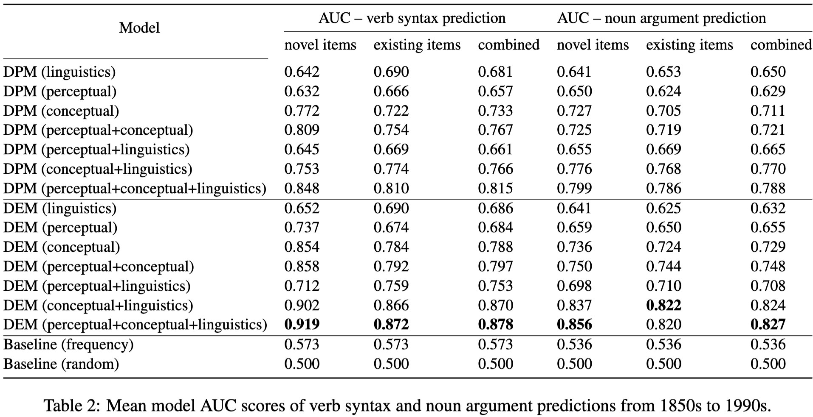
Evaluation Result
Notes:
Key takeaways

Slide 27
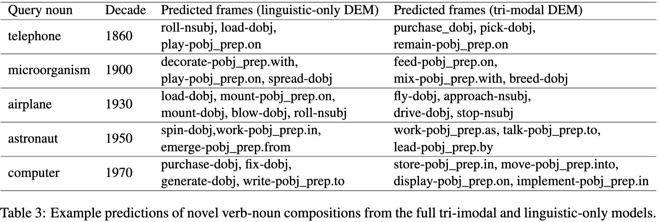
Evaluation Result
Notes:
Key takeaways

Slide 28
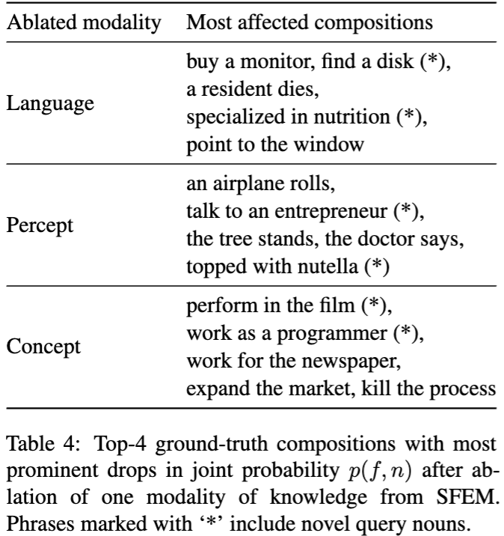
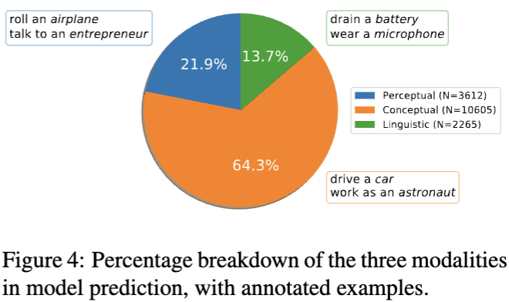
Interpretation

Slide 29
Computational Approach DPM 🆚 DEM (cont’d)

Slide 30
Conclusion
Presented a probabilistic framework Syntactic Frame Extension Model SFEM(-DEM)
The multimodal SFEM better predicts emerged verb syntax and arguments substantially than competitors with unimodal knowledge
Strengthens the link between multimodal semantics & cognitive linguistic theories of categorization

Slide 31
Future?

Slide 32
Reference
https://github.com/jadeleiyu/frame_extension
Lei Yu and Yang Xu. 2021. Predicting emergent linguistic compositions through time: Syntactic frame extension via multimodal chaining. In Proceedings of the 2021 Conference on Empirical Methods in Natural Language Processing, pages 920–931, Online and Punta Cana, Dominican Republic. Association for Computational Linguistics.
https://www.youtube.com/watch?v=udmCHRDI100&ab_channel=EnglishWithKhadiJa (on syntactic relations)

Slide 33
Thank you

